Slide 1
Present Perfect Simple (I have played) the 7th grade
Lesson plan
I he/she/it we/you/they | have played has played have played

Slide 8
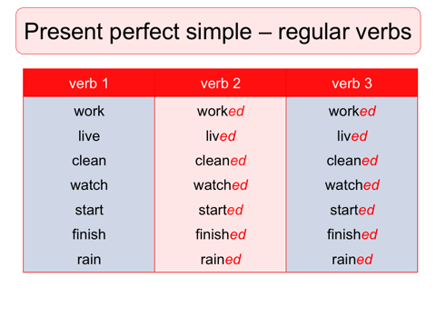

Slide 23
